Slide 1
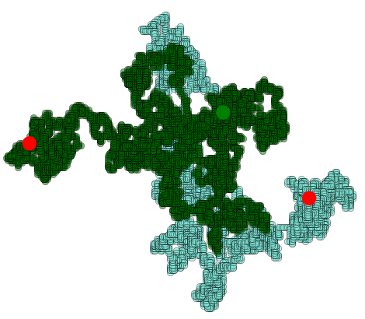
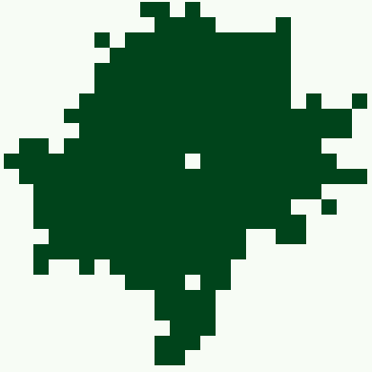
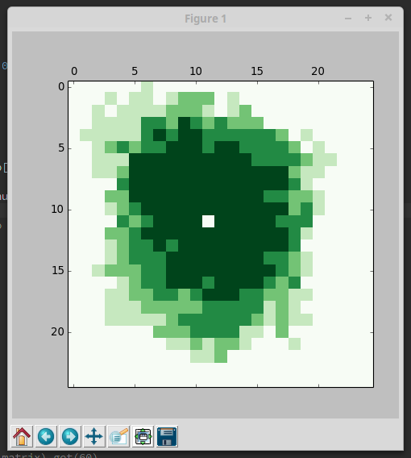
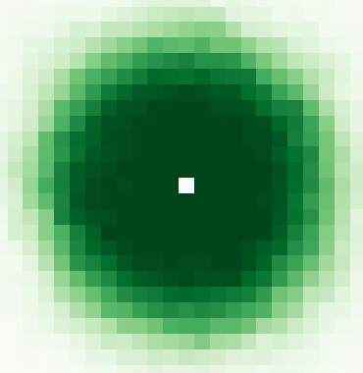
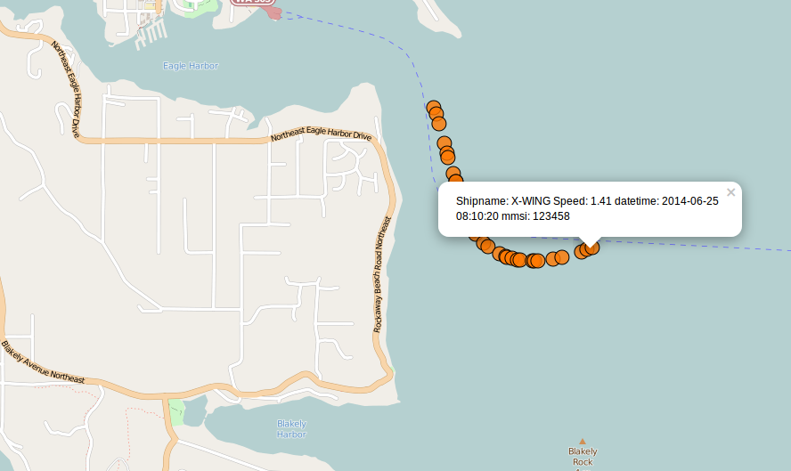
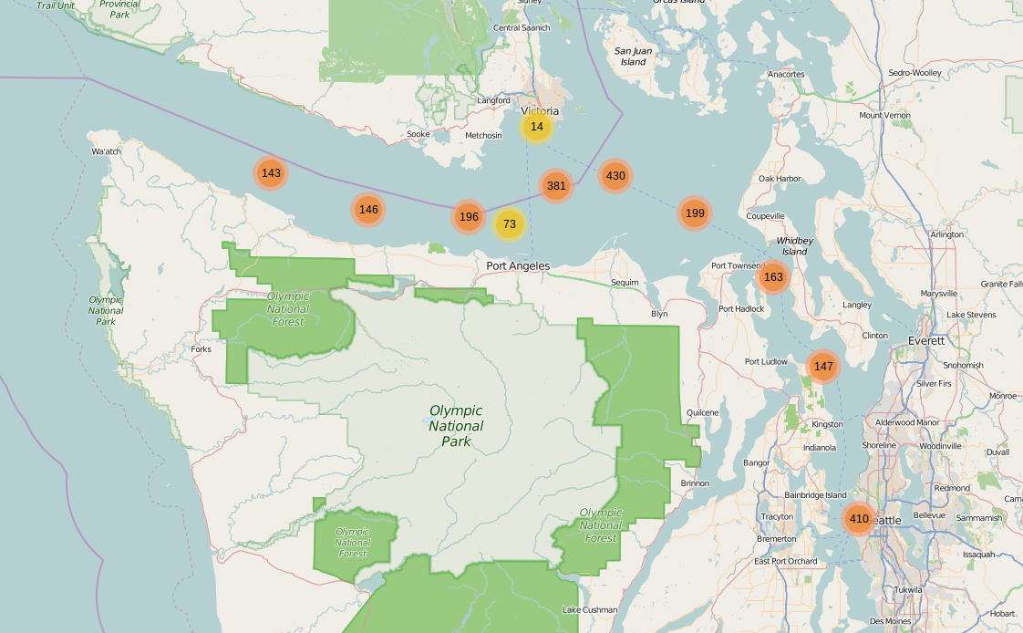
LAISIC
Aaron Hager, NREIP
2D random walk on {N, S, E, W}
Two walkers, 10000 steps
Used Python/Numpy
Random Radial Growth Model
Modeling forest growth
Single realization, 3 realizations, 100 realizations
Developed map application for AIS data. Populated Leaflet map from MySQLdb and data analysis in Python.
Notes:
Template V2
READ ME (NO REALLY) - Guidelines:
Do not change the master slide elements.
Do not change the slide (page) size.
Do not change the location of the title; edit it in place and center it in the grey box. Use Calibri (Body) 32 point font.
Do not change the shape/color of the color bars, rather move them, delete them, or rearrange them at will.
Use Arial Narrow font in text boxes as it displays well. Anything less than about 24 point font may be difficult to read.
The Event Coordinator or the Publications Branch will change the release statement at the bottom right of the slide to match the event venue.
Make sure you save the PowerPoint slide without compressing images. This is accomplished by modifying file save options (“File Save As” dialog box “Tools” dropdown / “Save Options…” / “Advanced” section / “Do not compress images in file” checkbox.
Save your PowerPoint slide using the file naming convention: “lastName-shortProjectName-ePoster-H” where the suffix ‘H’ indicates landscape/horizontal orientation. E.g., Laird-NISE-ePoster-H.pptx
<number>

